Slide 1

Design Lab –II (ME312P )
Dr. Himanshu Pathak
Dr. Sunny Zafar

Slide 2

What is Design Lab-II?
In conventional term: Theory of Machine Lab
Study of mechanism used to impart definite motion to its parts and machinery.
Understanding of mechanical device and their use in real life world.
Notes:
2

Slide 3
Course Reference & Evaluation
Textbook:
A. Ghosh, A. K. Mallik, Theory of Mechanisms and Machines, East West Press Pvt. Ltd.
Uicker, J. J., Shigley, J. E., and Pennock, G. R., Theory of Machines and Mechanisms, Oxford University Press.
Gardner D. Hiscox, Mechanical Appliances, Mechanical Movements and Novelties of Construction 2008th Edition.
SS Rattan, Theory of Machines, McGraw Hill Education; Fourth edition.
Assessment Scheme ???
Viva and Report Each Lab@5 marks 50
End Sem lab Exam 30
End Sem Viva 20
Total 100
himanshu@iitmandi.ac.in
sunny@iitmandi.ac.in
Lab Session: Tues, 2:00 – 4:00 PM
Notes:
3

Slide 4
Course Objective
Students who successfully complete the course will demonstrate the following outcomes by lab session:
Students will be able to identify functional characteristics various machine elements.
Students will demonstrate the ability to synthesize and analyse mechanisms.
Students will demonstrate ability to design and analyse cams.
Students will demonstrate the ability analyse gear trains.
A knowledge of various kind of vibrating system, analyses of reciprocating mass, and journal bearing systems.
Notes:
4

Slide 5
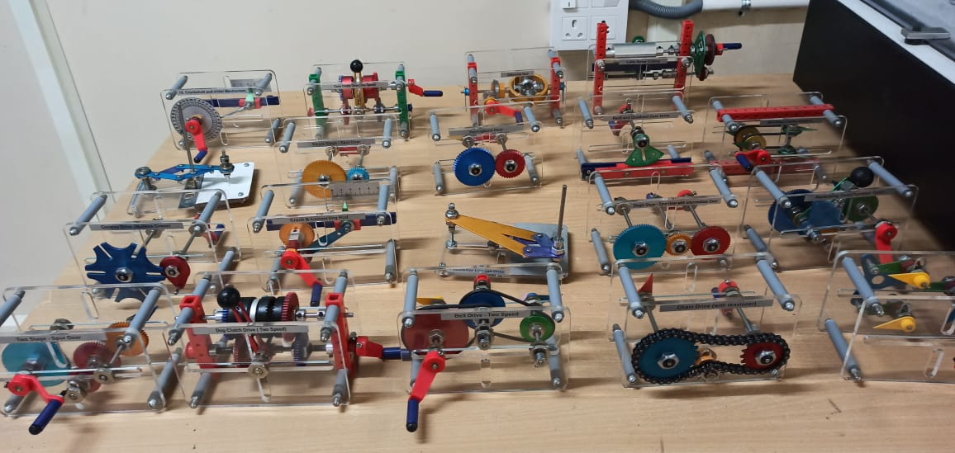
To study kinematic chain and their inversions.
Notes:
5

Slide 6
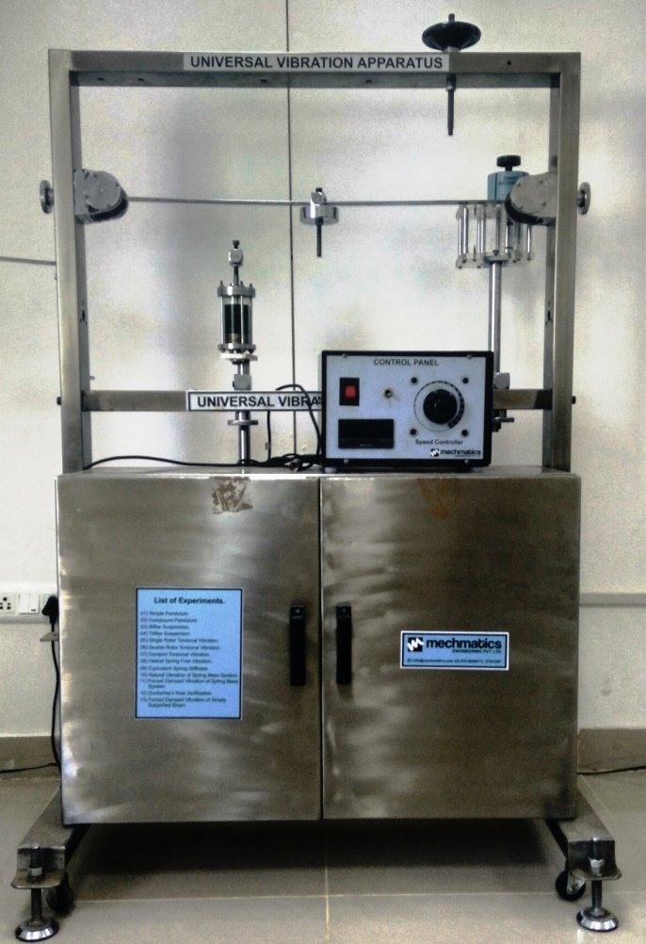
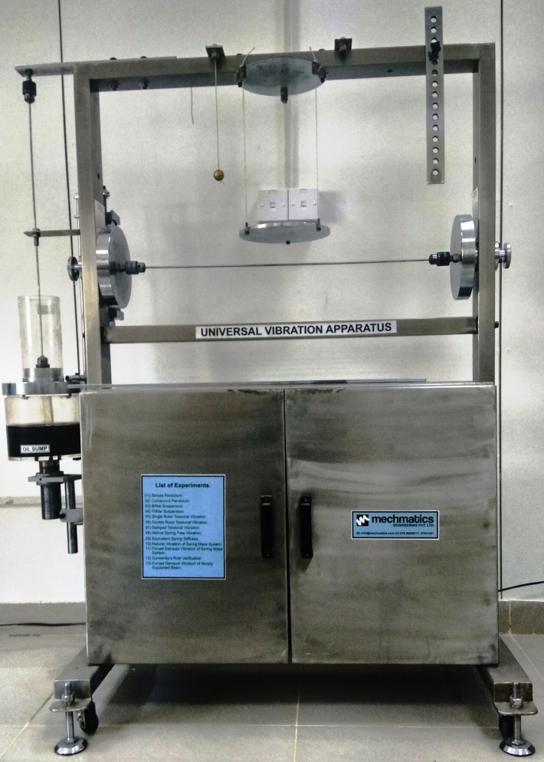
To study the oscillation of simple pendulum.
To determine the radius of gyration of a compound pendulum.
To determine radius of gyration of disc using Trifilar suspension.
Notes:
6

Slide 7
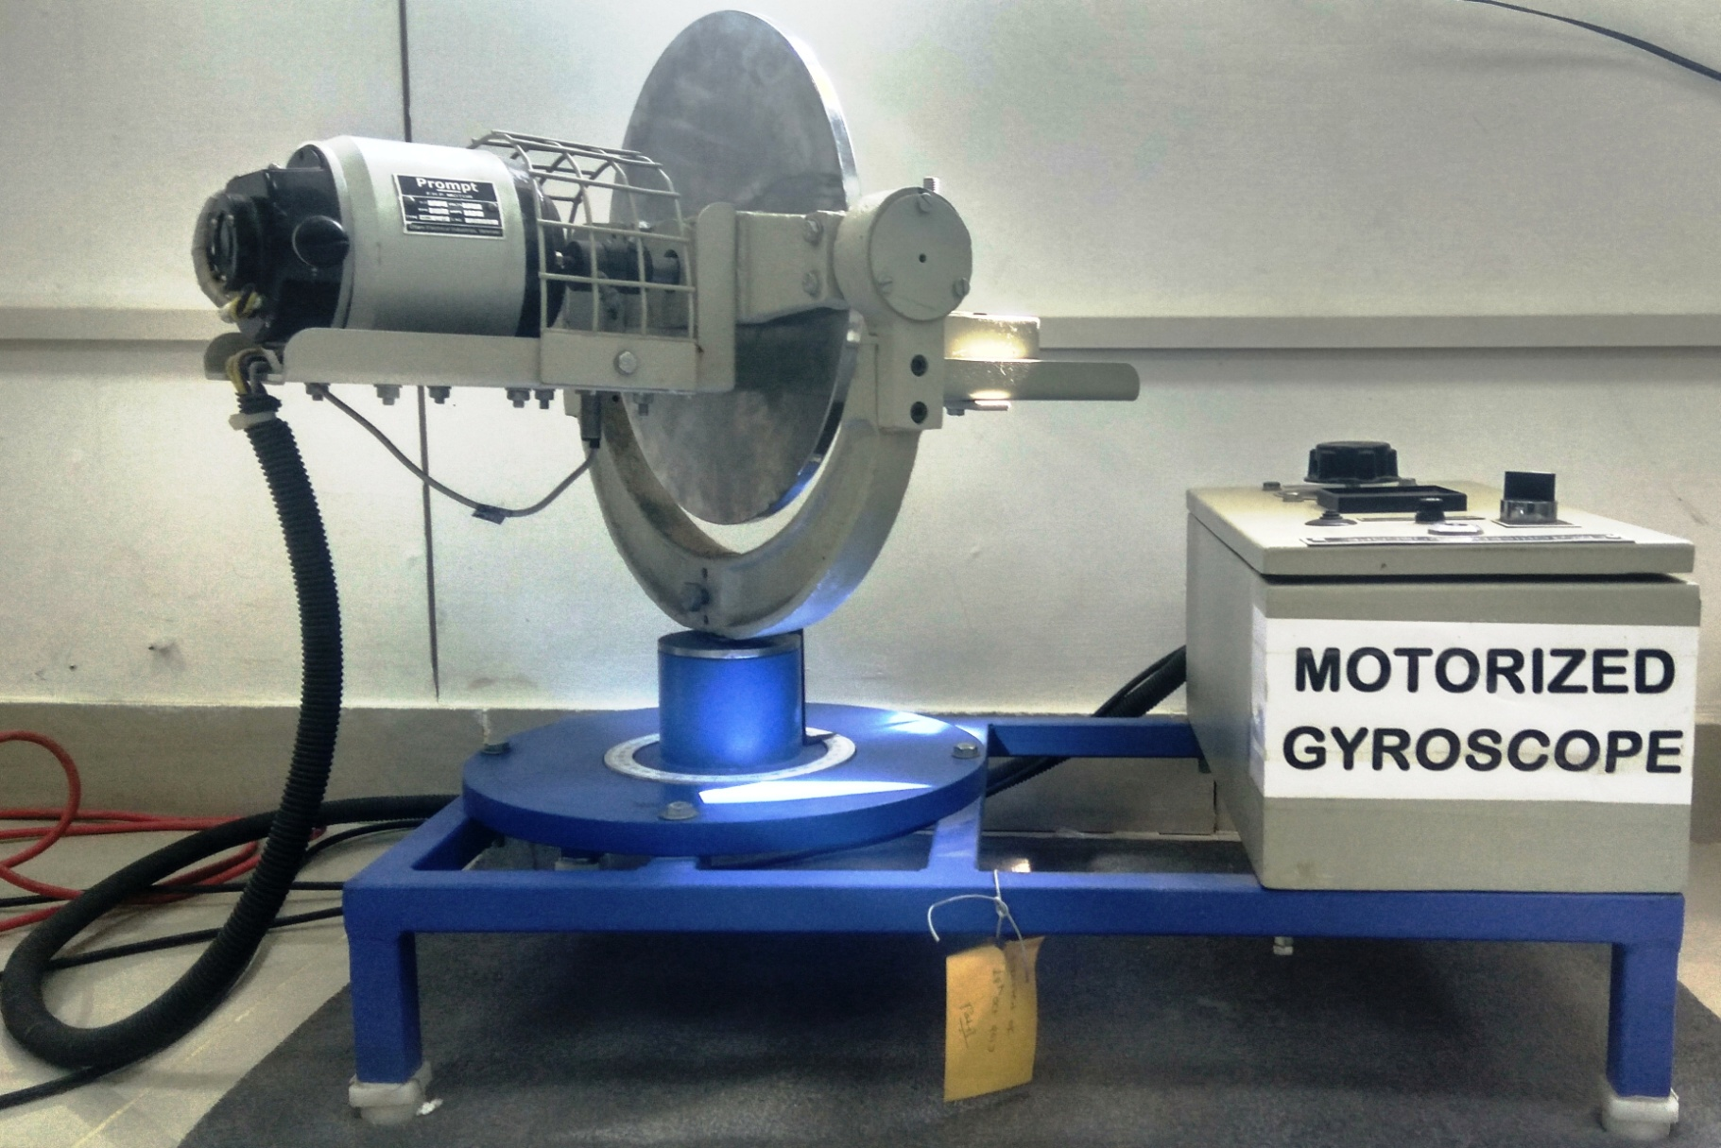
Study of Gyroscopic effect and determination of gyroscopic couple.
Notes:
7

Slide 8
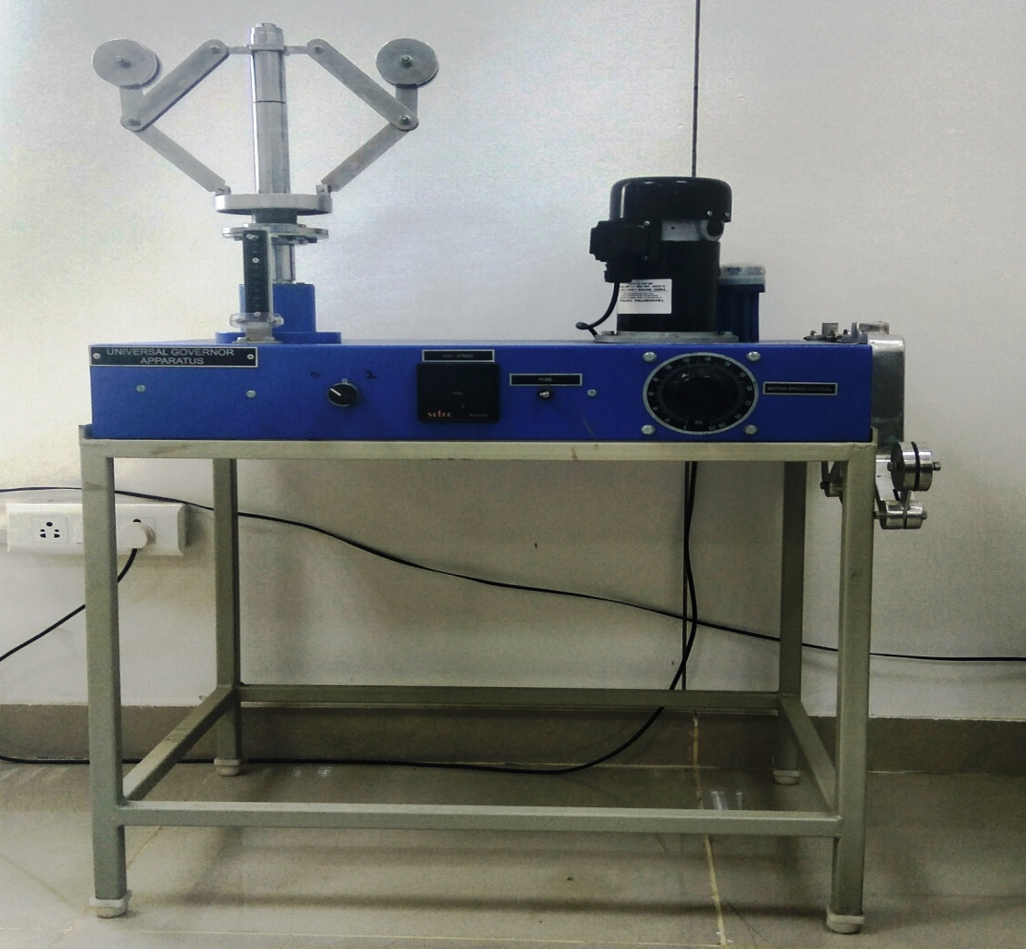
To determine the position of sleeve against controlling force and speed of Watt, Porter, Proell and Hartnell governor. Plot the characteristic curve of radius of rotation against force.
Notes:
8

Slide 9
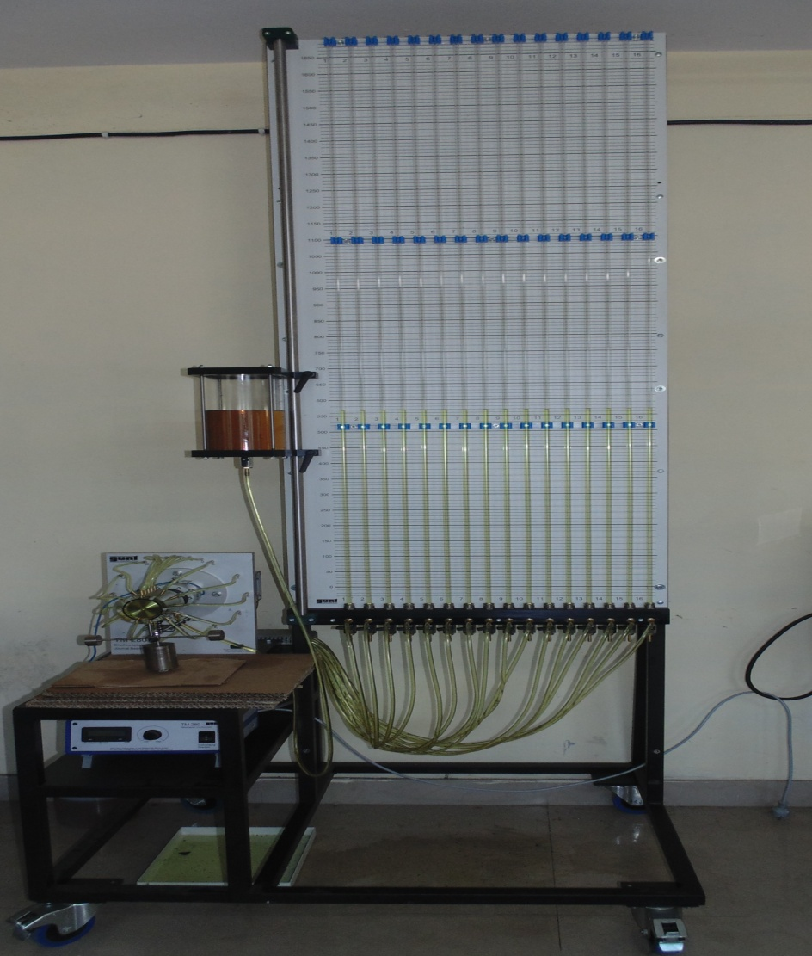
This experiment demonstrates pressure distribution with hydrodynamically lubricated radial sleeve bearings. The pressure distribution around the perimeter and in axial direction is illustrated with the aid of the 16 tubes.
Notes:
9

Slide 10
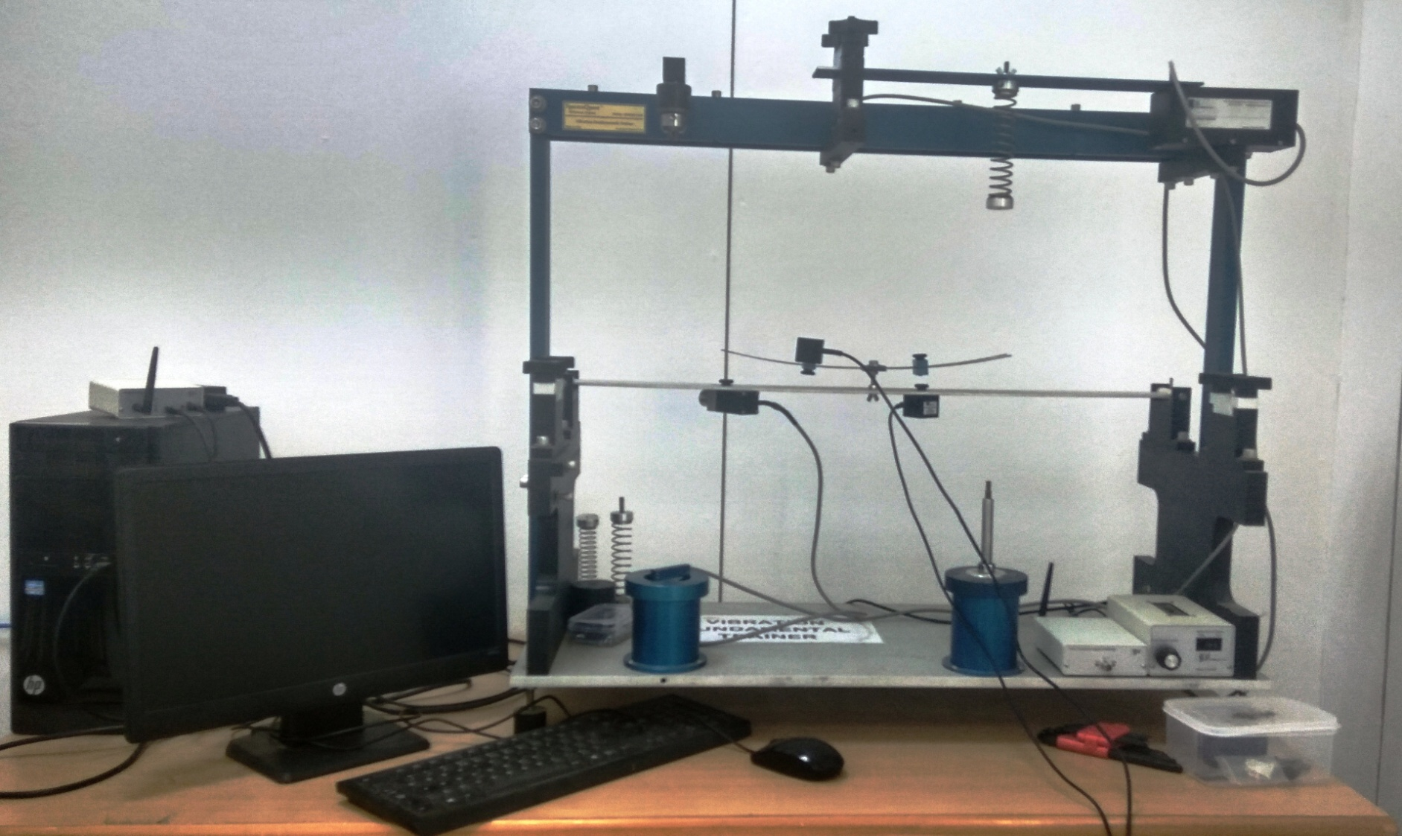
Demonstrate the effective passive vibration control treatment.
Notes:
10

Slide 11
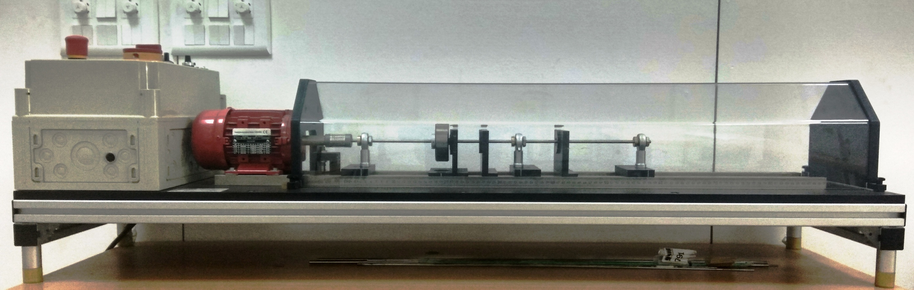
In this experiment the oscillation behaviour of an elastic shaft will be studied. Phenomena such as resonance and self-centring will be particularly clear in the over-critical range.
Notes:
11

Slide 12
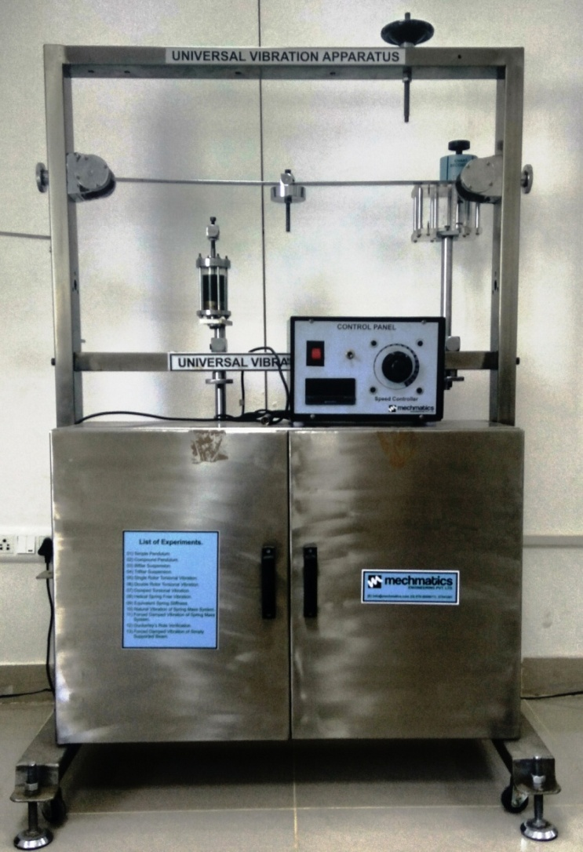
To study the torsional vibrations of two rotor system.
To study damped torsional vibrations of single rotor system.
Notes:
12

Slide 13
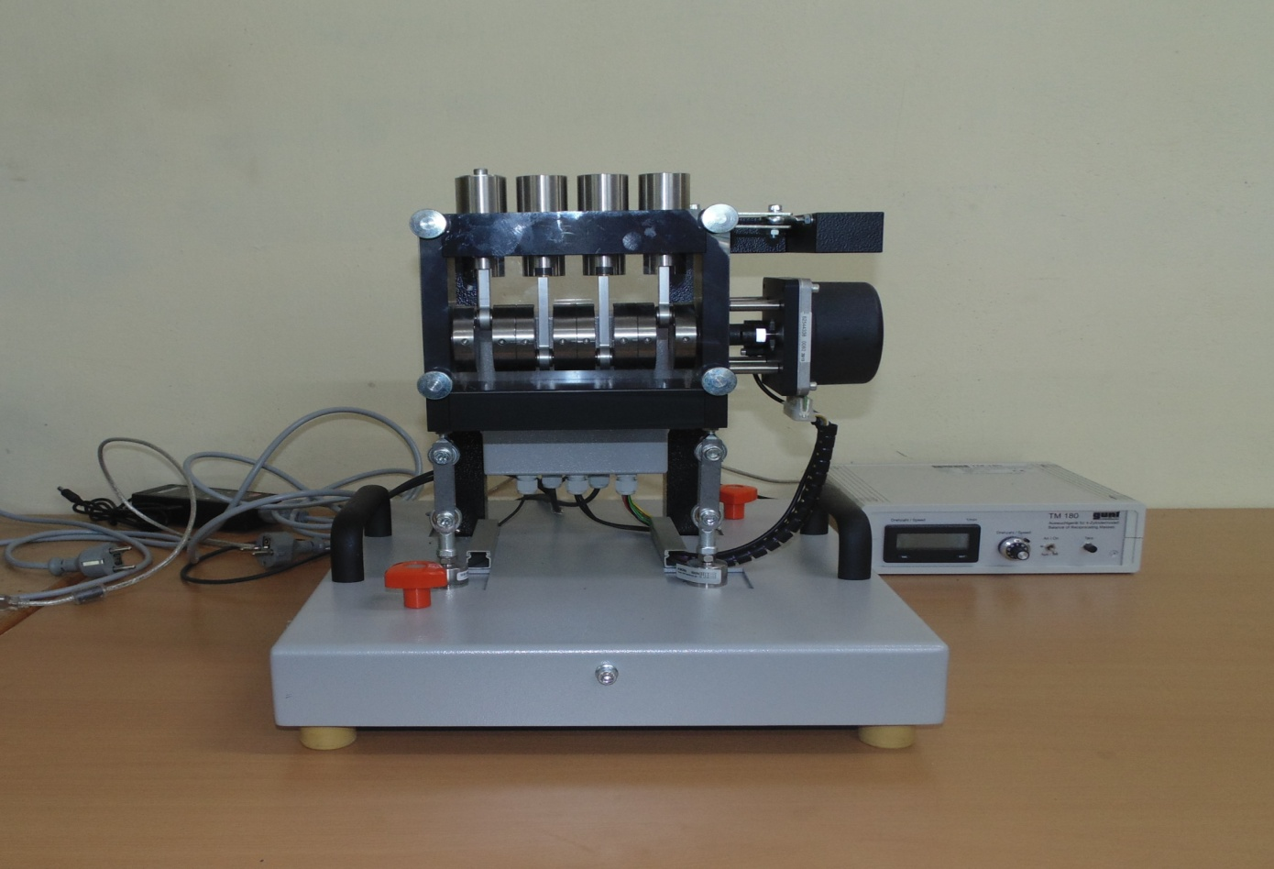
The TM 180 4-cylinder model is used to investigate the free mass forces and mass moments of a reciprocating engine. To prove the characteristic free mass forces and 1st and 2nd order moments for the respective reciprocating engines using the 4-cylinder model TM 180 and the associated software.
Notes:
13

Slide 14
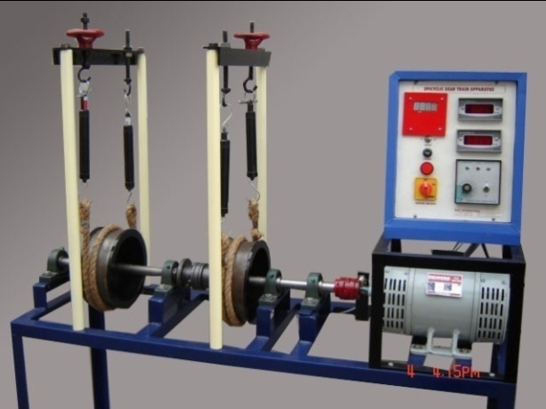
To measure Epicyclic gear ratio between input Shaft and output shaft.
To measure input torque, holding torque and output torque of epicyclic gear train system.
Notes:
14

Slide 15
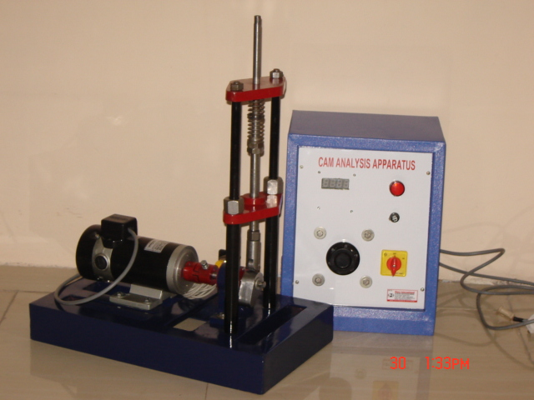
Plotting and analysis of cam profile contour with different shapes of cam and follower.
To study the effect of follower weights (W) on the speed of bounce.
Notes:
15

